Slide 1
i

Slide 2
Puzzles

Slide 4
The Stables
https://sketchfab.com/3d-models/the-stables-82abdb57429b4074a9b42eb6f74eeb49

Slide 5
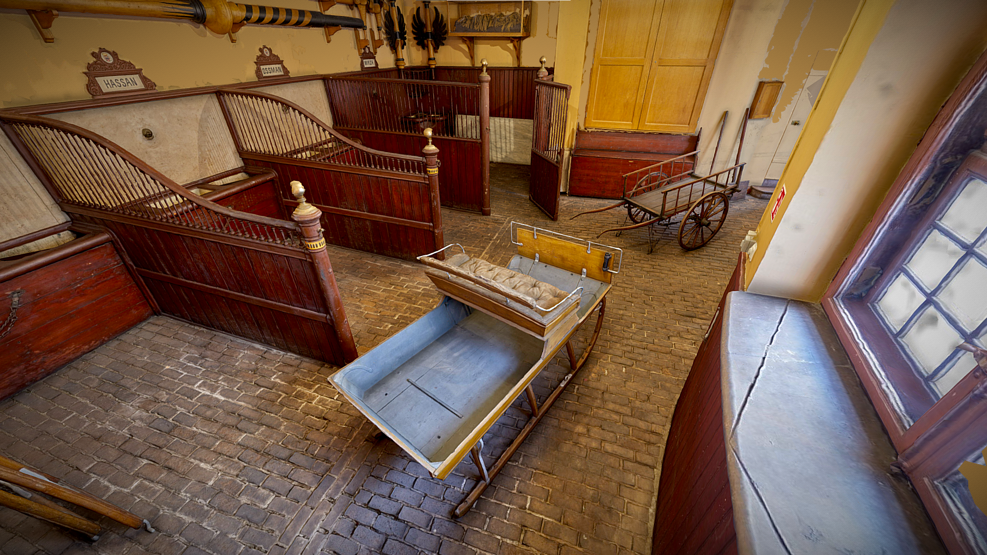

Slide 6
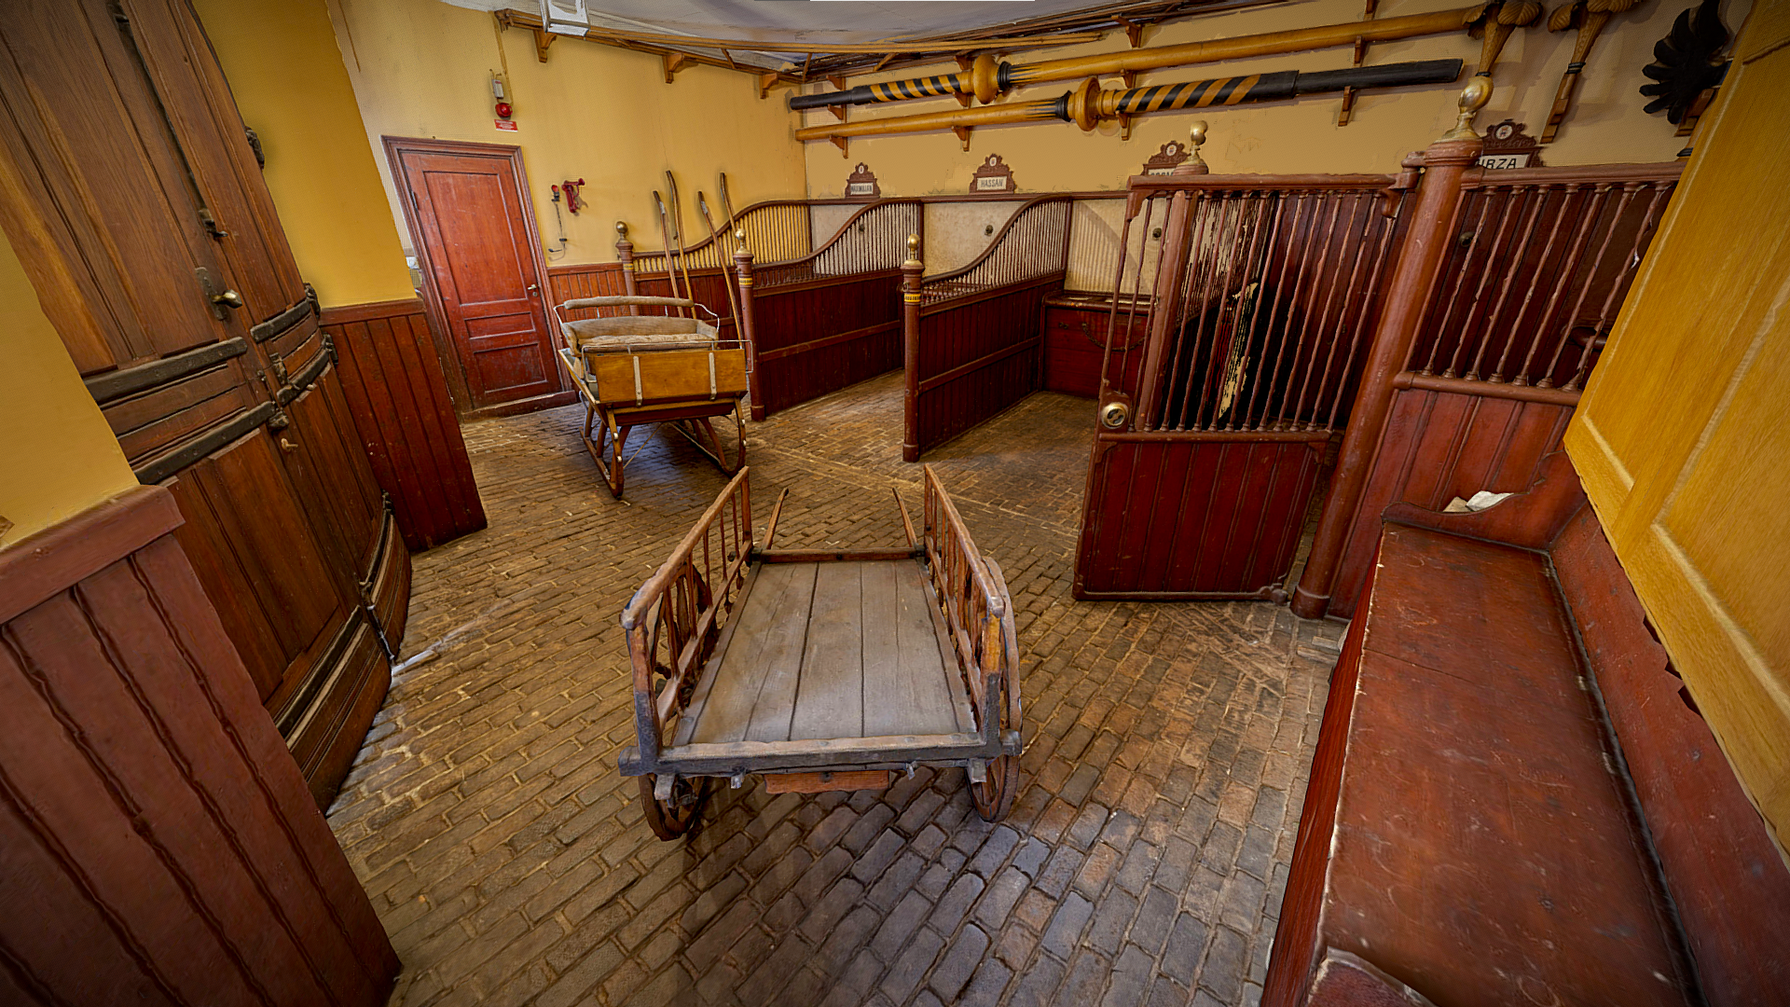

Slide 7
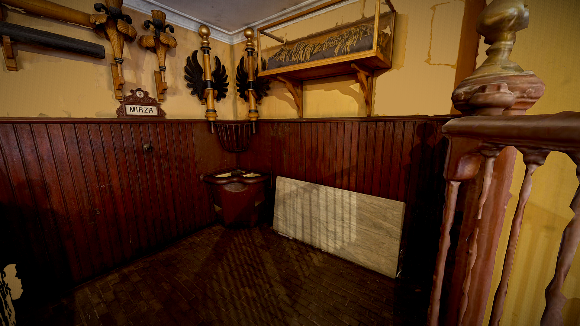

Slide 8
The Armoury
https://sketchfab.com/3d-models/the-armoury-adbe88dcf04d4a87a4c2f62ed6ca0880

Slide 9
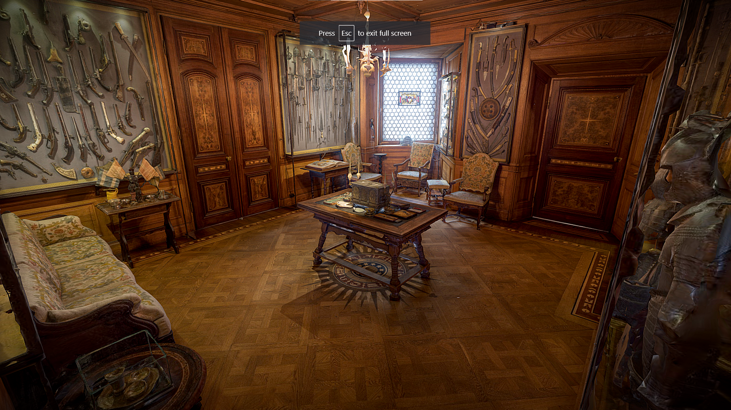

Slide 10
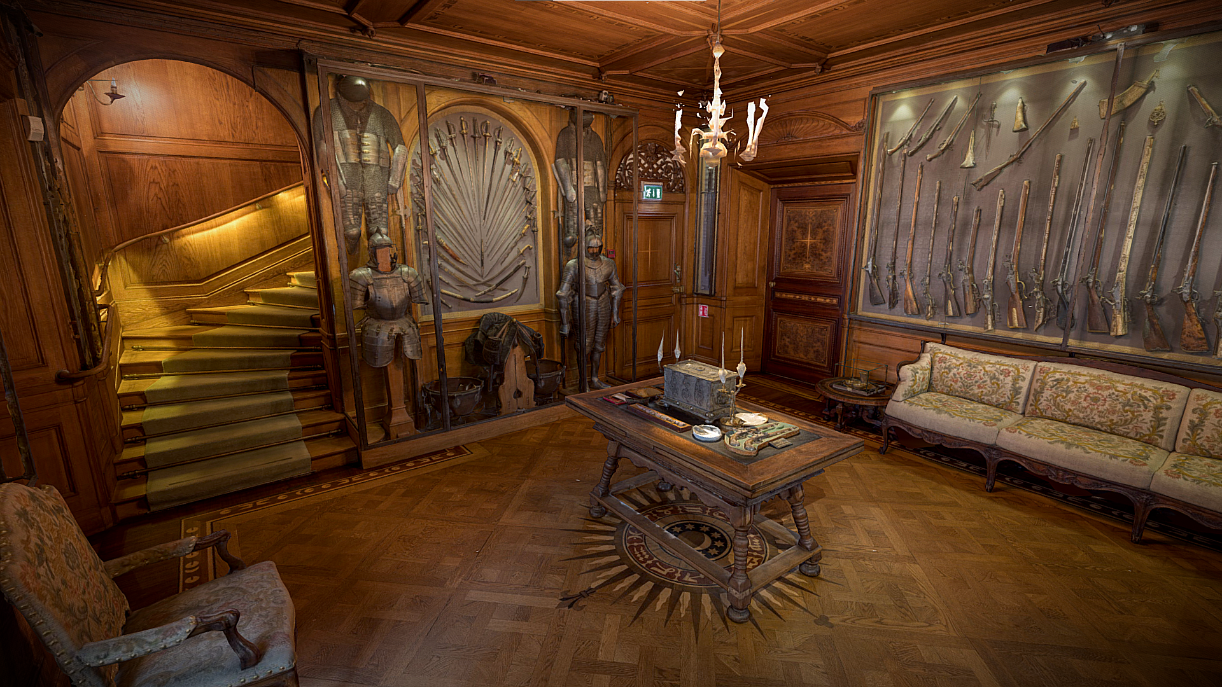

Slide 11
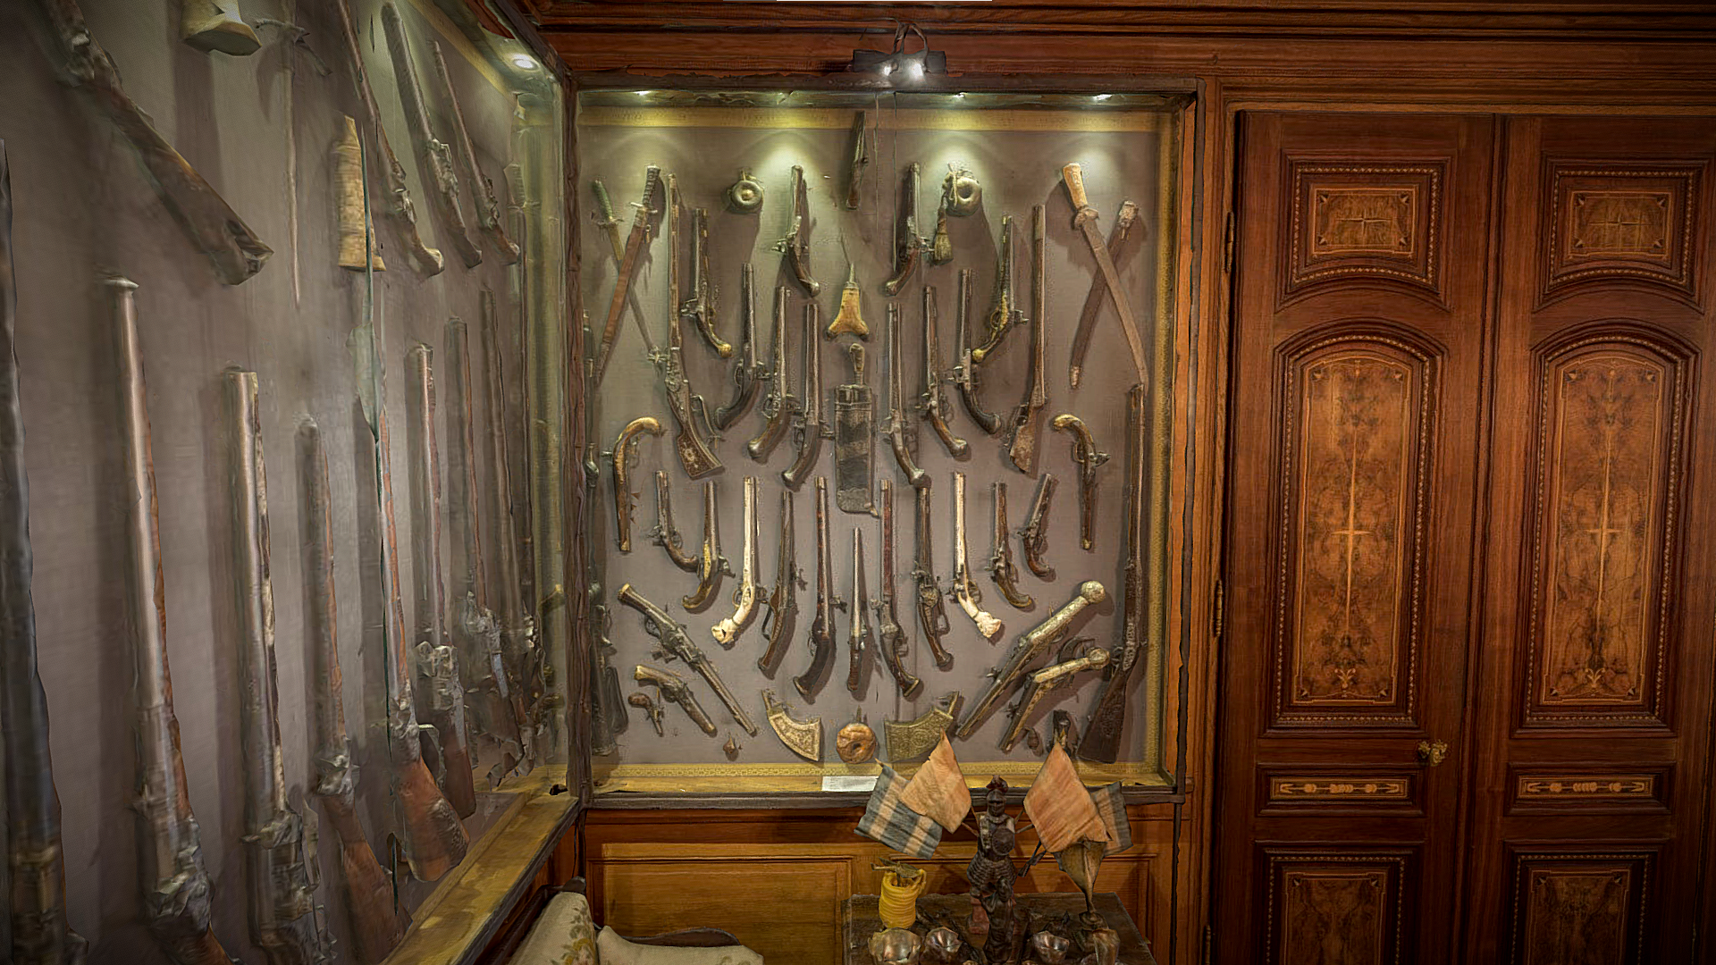

Slide 12
Billiards Room
https://sketchfab.com/3d-models/the-billiards-room-79615d823a9149069dcd06c20bc9707f

Slide 13
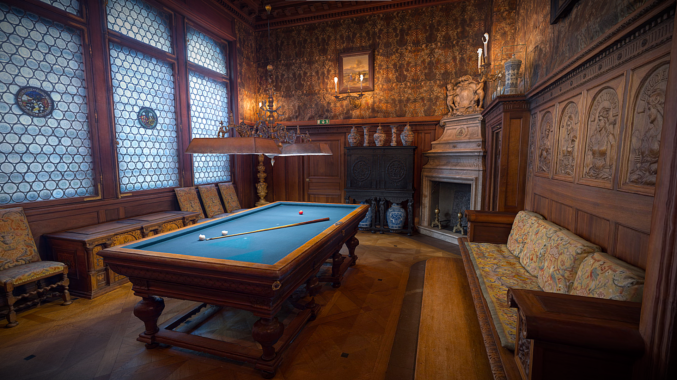

Slide 14
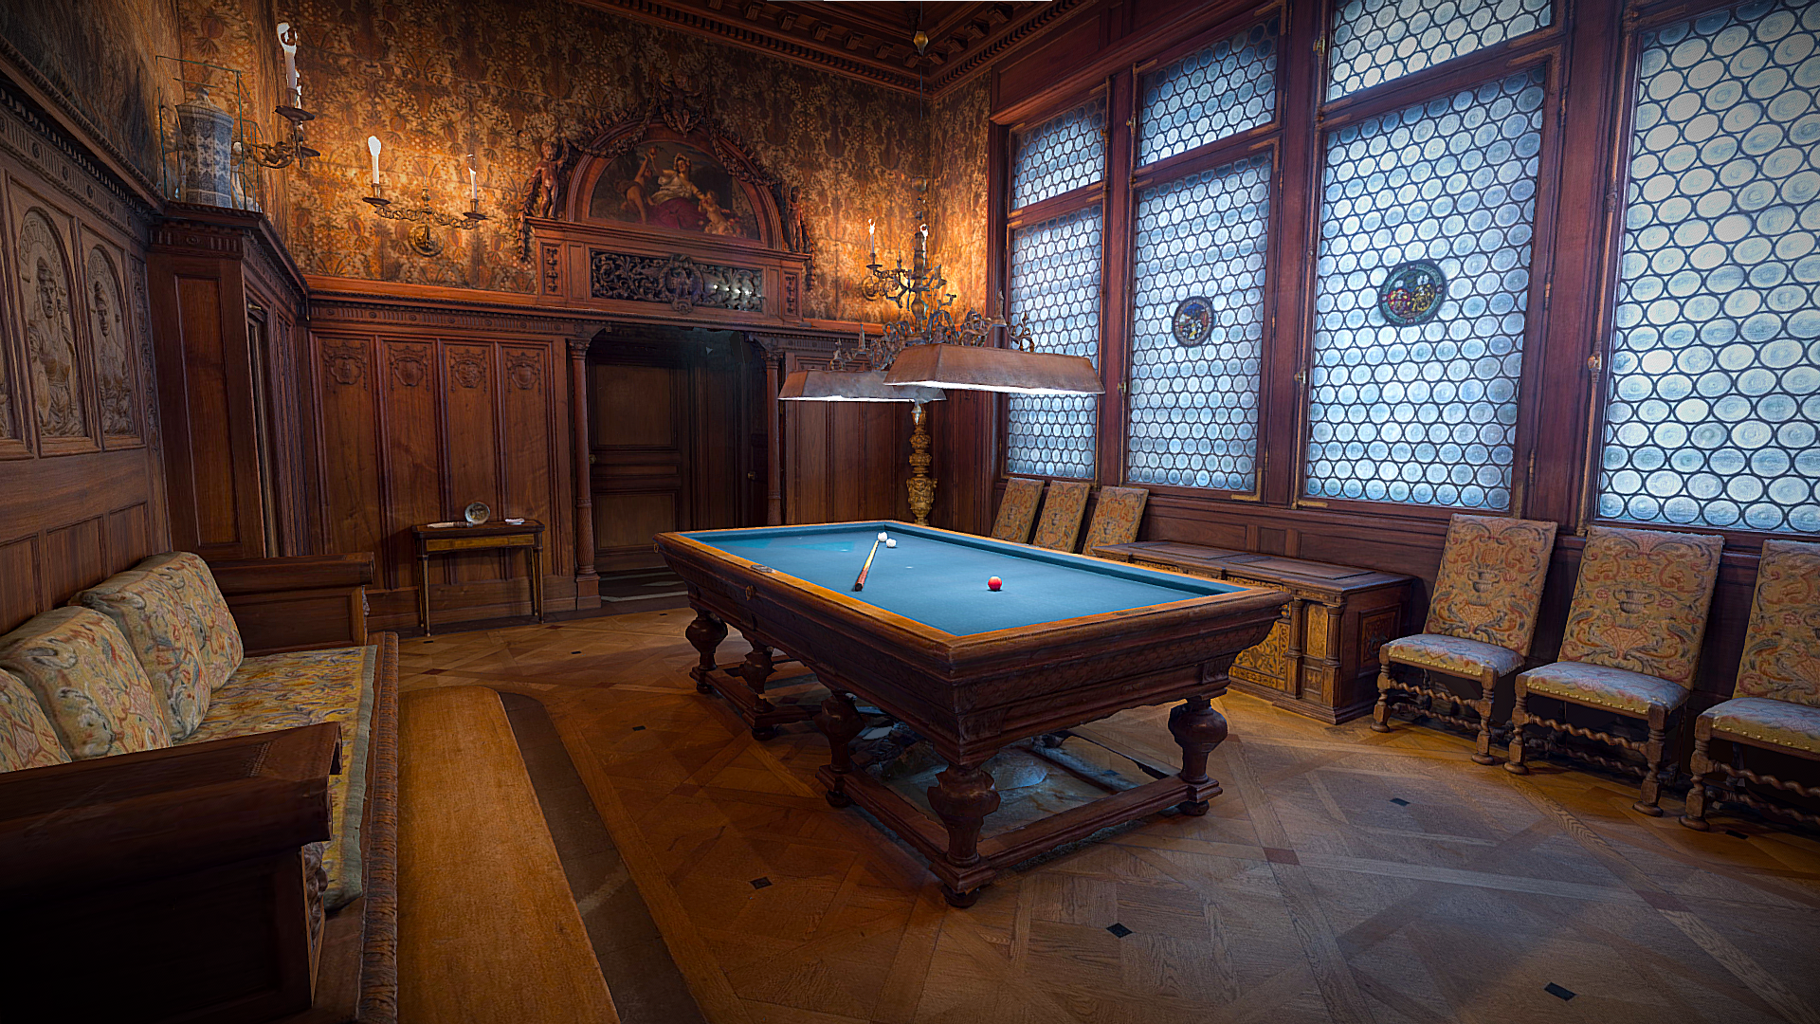

Slide 15
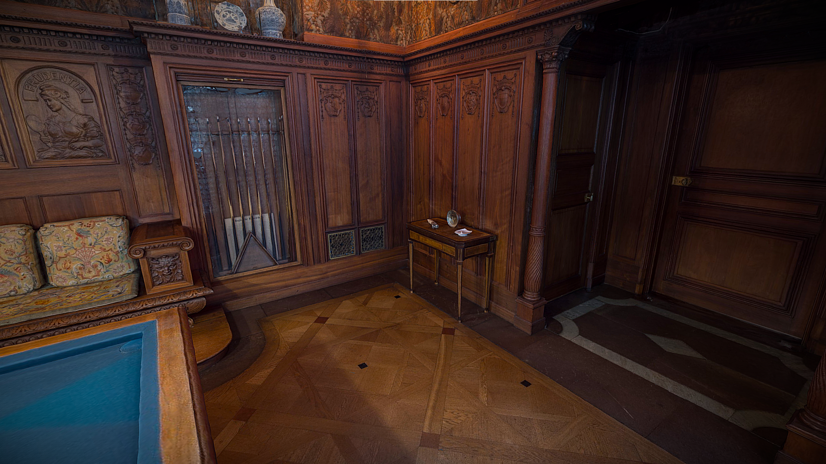

Slide 16
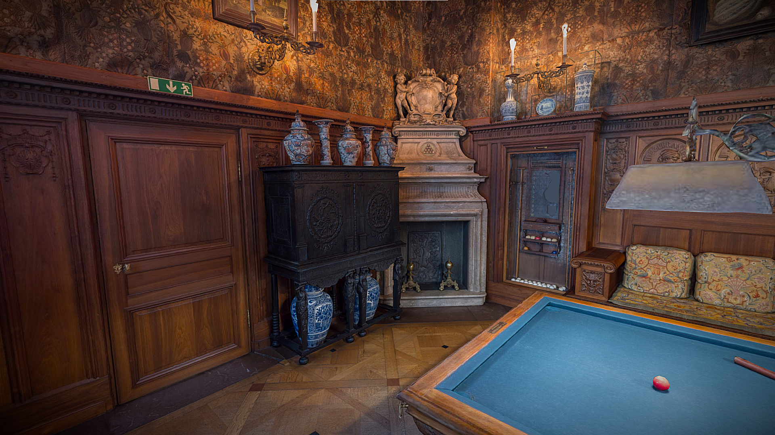

Slide 17
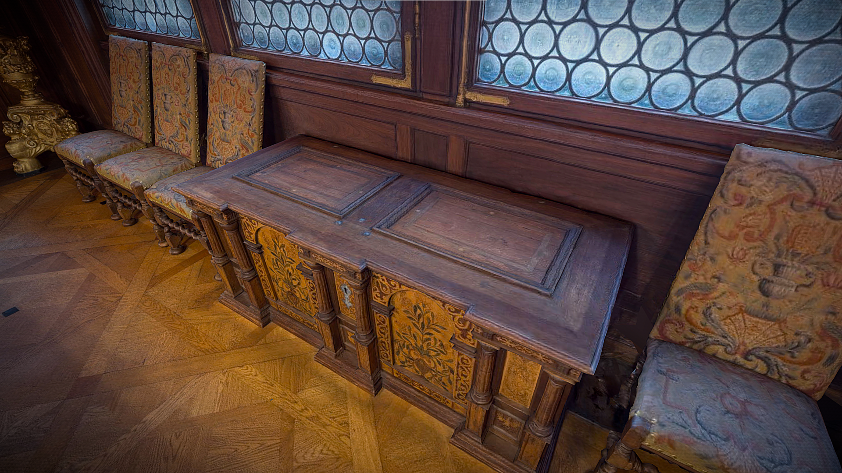

Slide 18
Smoking Room
https://sketchfab.com/3d-models/the-smoking-room-2247ed77976a40b6ae81271cd6b149c8

Slide 19
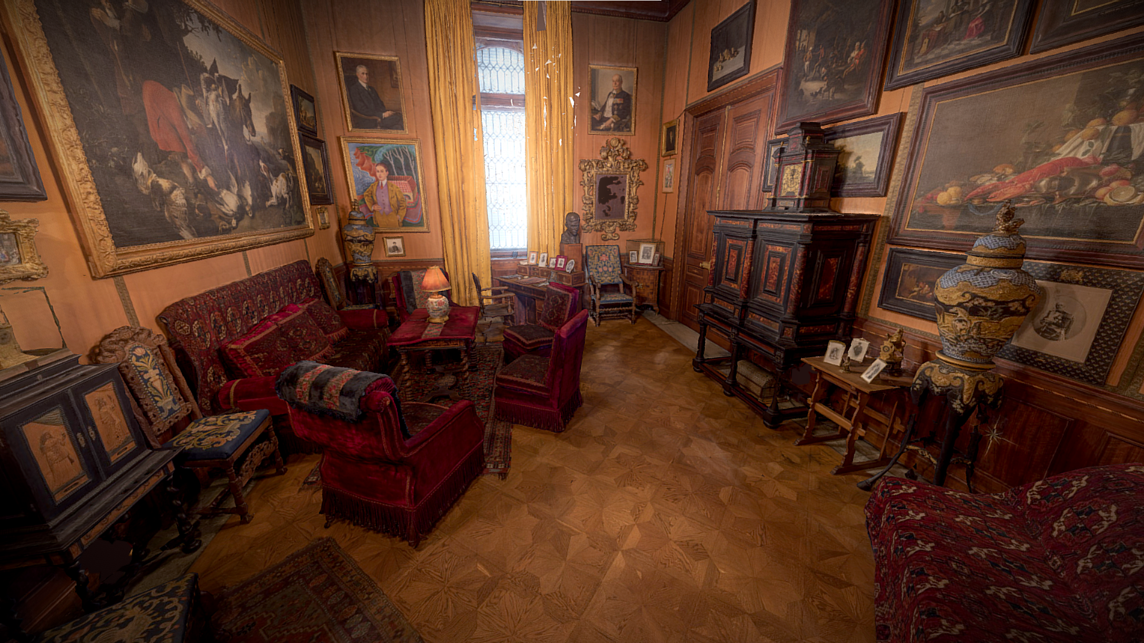

Slide 20
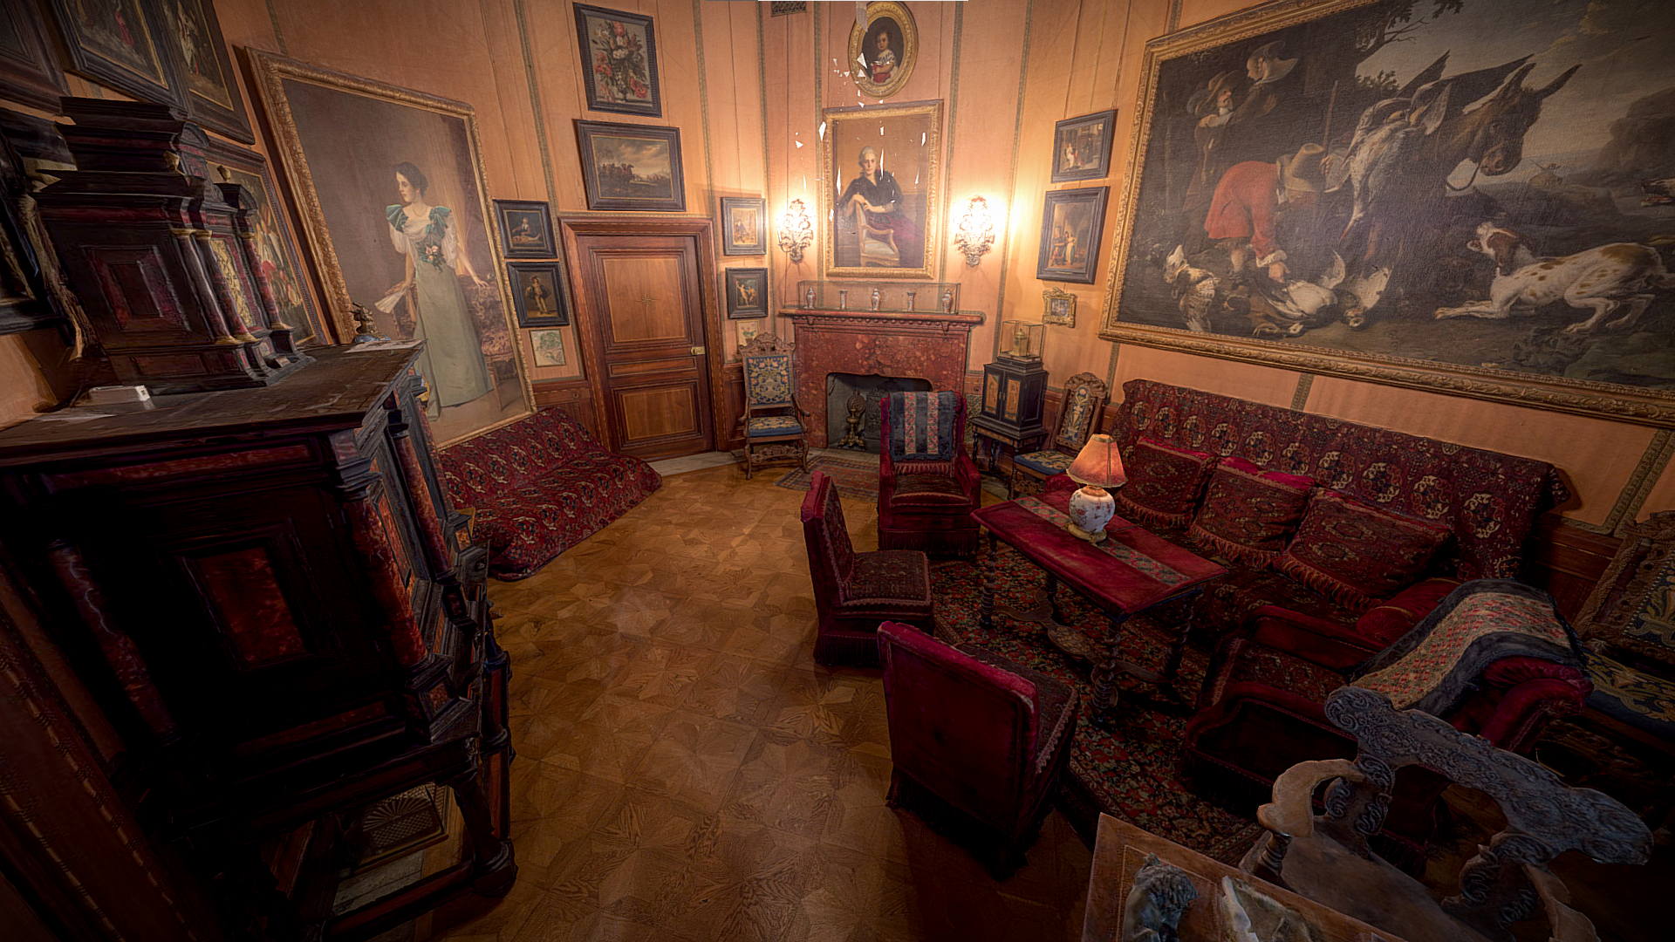

Slide 21
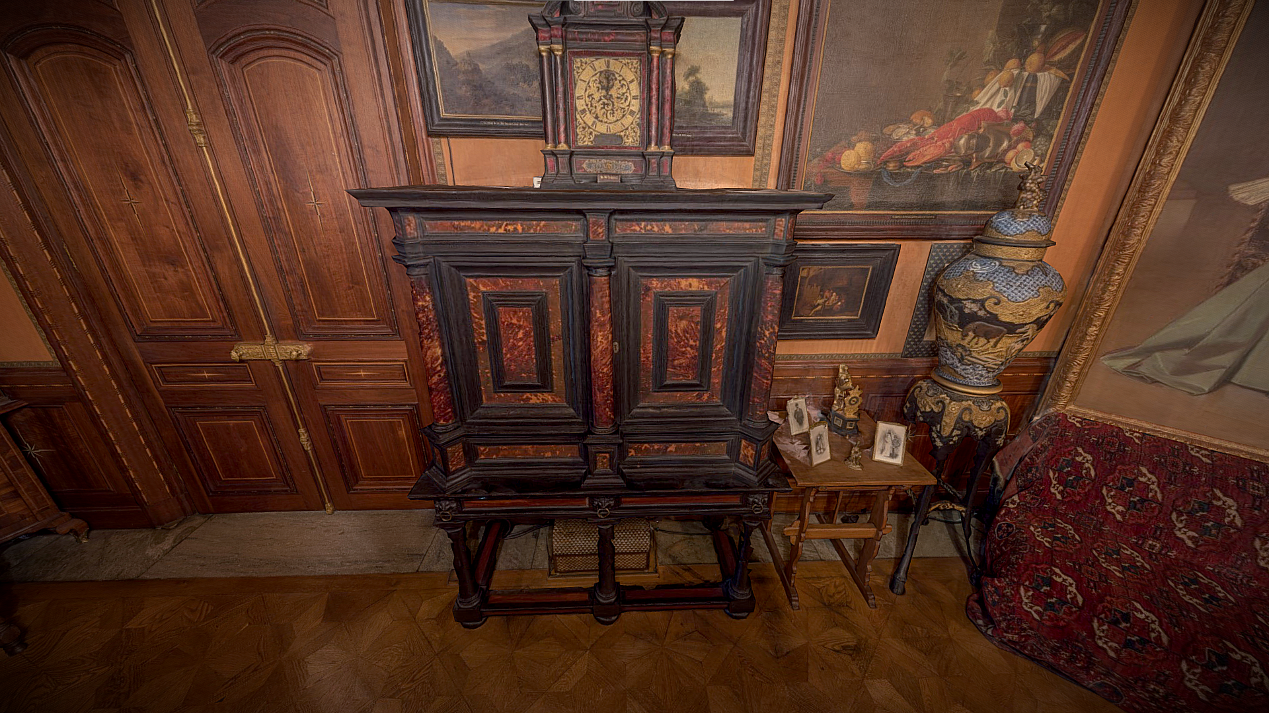

Slide 22
